Slide 1

Starter
Can you think of any skills and strengths Katniss possesses, which may help in the Hunger Games arena?
Brainstorm the question above in your books.

Slide 2
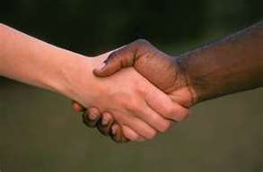
Learning Objective
To explore a key theme of the book.

Slide 3
The Theme of Humanity
Humanity: The quality or condition of being human; human nature.
Example of humanity from The Hunger Games:
When Peeta was sneaking bread for Katniss and her family at his father’s bakery shop. He would get in trouble with his mother, but he knew Katniss was starving so he helped.
Create a new theme page in your books for Humanity.
Can you think of any other examples of humanity from the book so far?

Slide 4
Chapter 6
‘“Because, of course, Haymitch hasn’t bothered to tell me
your strategies. But I’ve done my best with what I had to
work with. How Katniss sacrificed herself for her sister. How
you’ve both successfully struggled to overcome the barbarism
of your district.”
Barbarism? That’s ironic coming from a
woman helping to prepare us for slaughter. And what’s she
basing our success on? Our table manners?’
What does Effie Trinket count as barbarism?
What does Katniss count as barbarism?
What do you think are the characteristics of ‘humanity’?
Add your ideas to your ‘Humanity’ theme page.

